Slide 1





Sensor Level Analysis ERP EEGLAB
Romain Grandchamp, PhD
Johanna Wagner, PhD
Ramon Martinez-Cancino, PhD
Arnaud Delorme, PhD
Practical MEEG 2025, Aix-Marseille Université, France, October, 2025

Slide 2
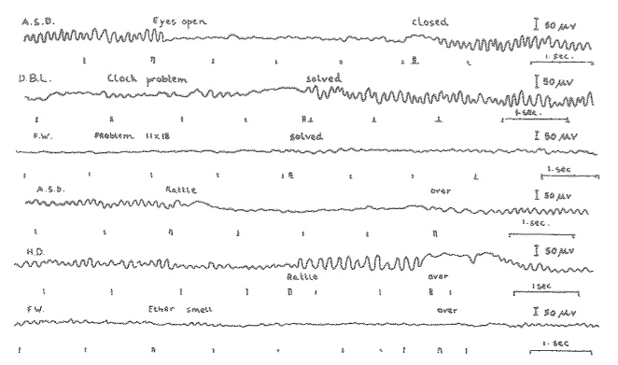
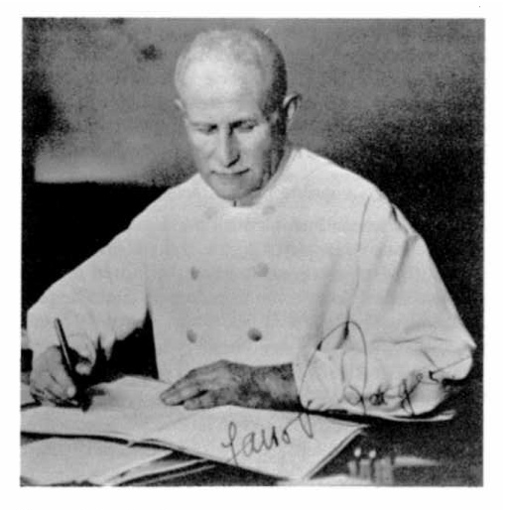
Human Electrophysiology
Some EEG milestones
1926 ~1st first EEG recordings
1938 1st EEG spectral analysis
1962 1st computer for EP averaging (CAT)
Event-related potential (ERP) averaging
1979 1st source localization of EEG/MEG
Functional EEG brain imaging
1995 1st multisource EEG filtering by ICA
2009 ~1st commercial dry electrode devices
S. Makeig, 2009

Slide 3
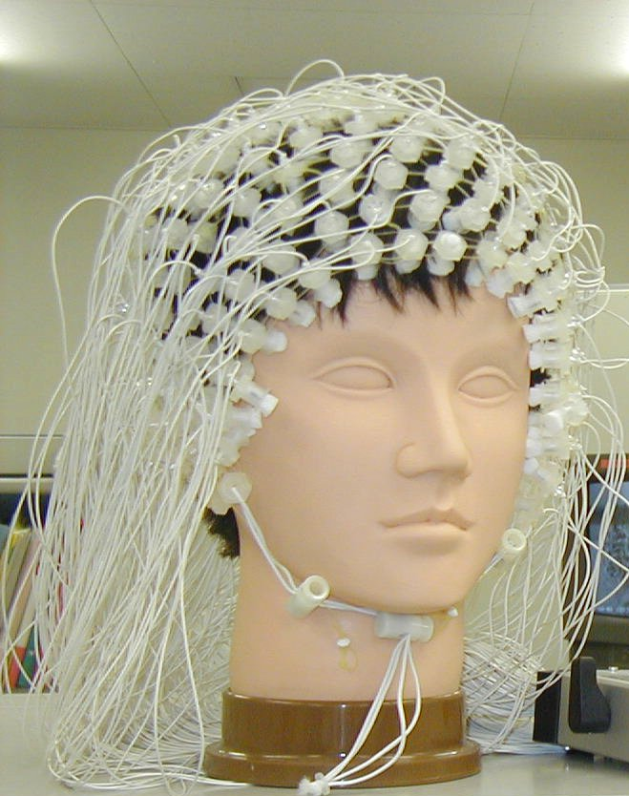
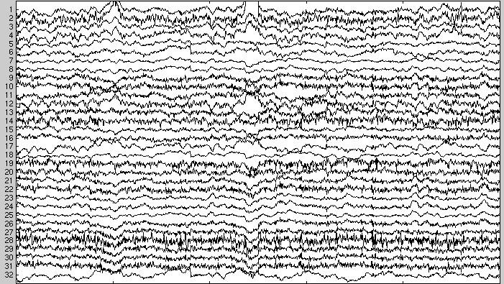
ERP Experiment
Recording
Offline
processing
Electrodes
Time (ms)‏

Slide 4
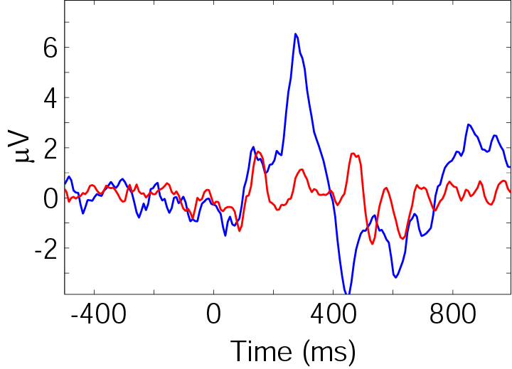
Electrode X
Baseline removal
Average

Slide 5
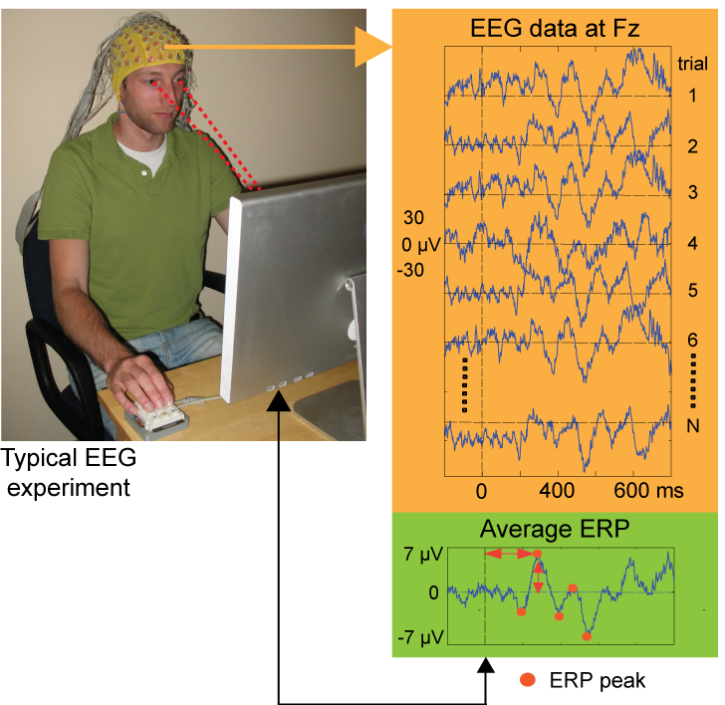
Notes:
EEG Data Reduction. Unfortunately, largely for fear of contamination of the EEG signals with muscle and eye movement potentials, traditional cognitive EEG / ERP experimental paradigms called for subjects to fixate a cross at screen center and to hold their head and eyes still. Behavior was most often recorded in the form of occasional finger ‘microswitch’ button presses. Trials following one or more classes of events thought– in advance – to give ‘the same’ brain response were then averaged to form the Event-Related Potential average. These time series were then further reduced to a small table of waveform peak amplitudes and latencies – thus simplifying the data to approximately the level of the behavioral record.

Slide 6
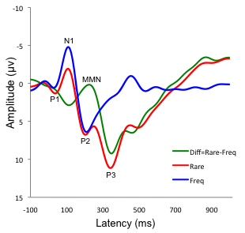
Examples of ERPs
Event-related-potential article on Wikipedia
Adapted from McFadden, K.L. et al. (2011) Journal of neurotrauma 28, 21-34.

Slide 7
Limitations of the ERP model
Data ≡ Average + “Background”
EEG ERP EEG “noise”
But, this linear decomposition is veridical if and only if:
1. The Average appears in each trial.
2. The Background is not perturbed in other ways by the time locking events.

Slide 8
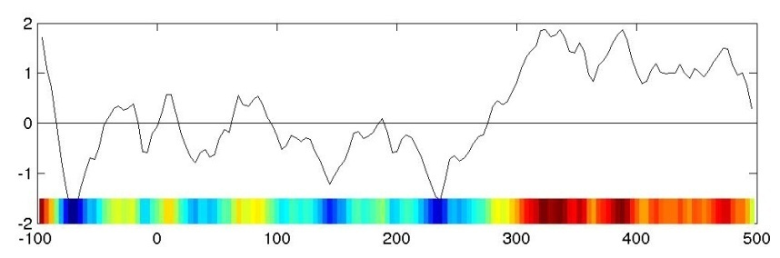
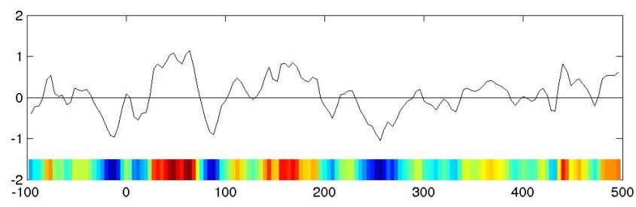
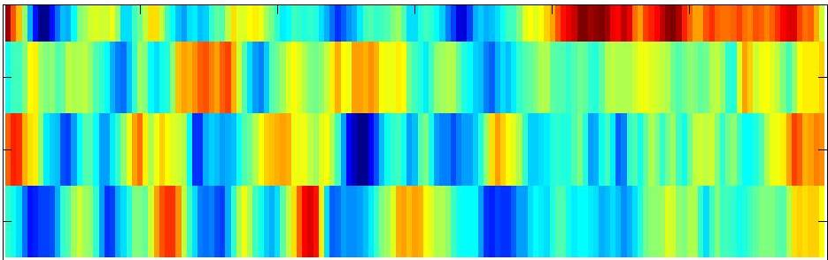
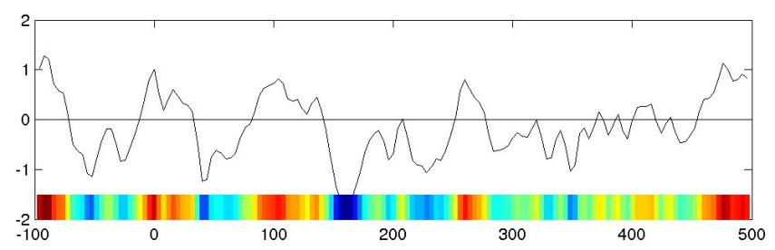
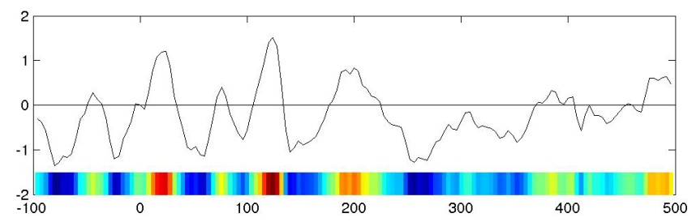
ERP Image
Trial 1
ERP Image
Trial 2
Trial 3
by default, sorted by
time-on-task
(1st trial, 2nd trial, ...)
Trial 4

Slide 9
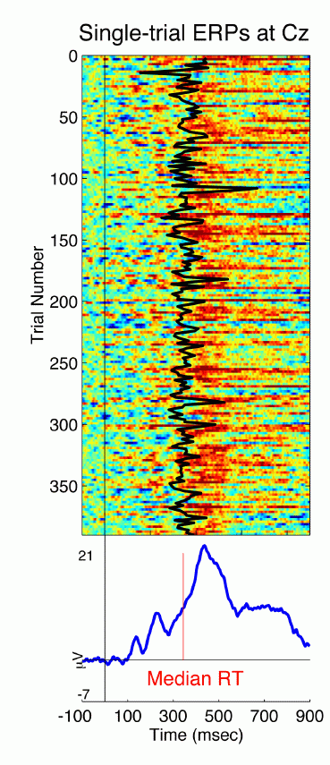
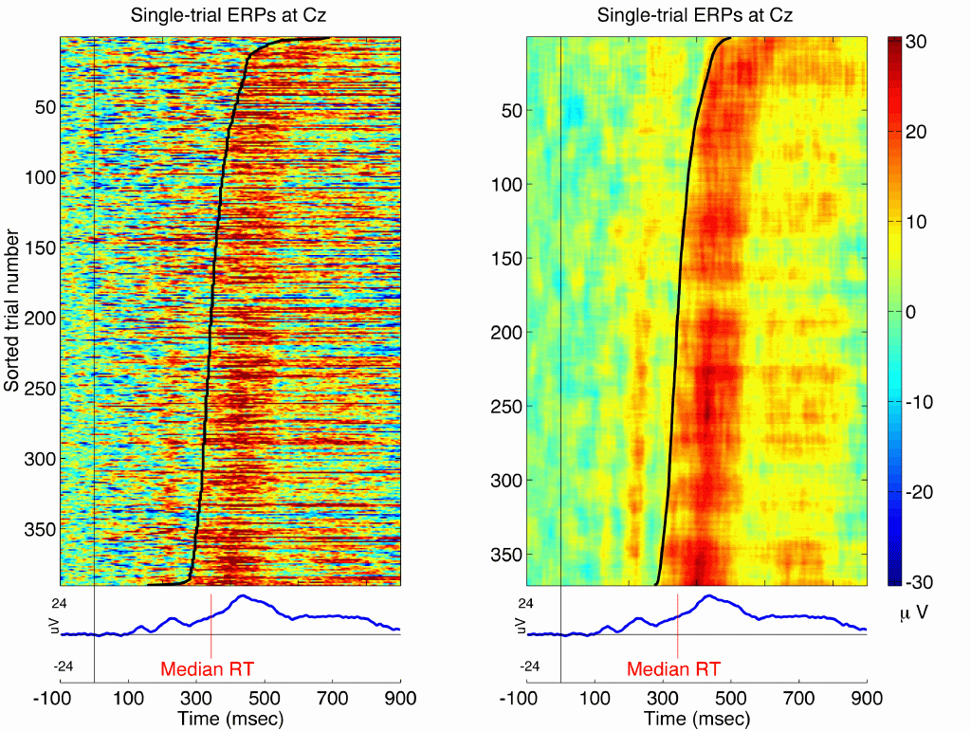
ERP Image
Unsorted
Sorted
Sorted and smoothed
Notes:
This figures show 3 single-trial EEG epochs time-locked to occurrences of target stimuli and measured at one central electrode (Cz). In stead of plotting potentials in time series, we can plot potentials in different colors according to the color bar on the right. We can stack all target responses during a session. This figure shows 390 single-trial ERPs.
Each trace represents one single-trial target epoch.
Time goes left to right from -100 to 900 msec.
Stimuli were presented at the vertical line at Time 0.
The thick line shows the reaction times.
Notice the trial-to-trial fluctuations in reaction time and response latency.
The average of all 390 trials, shown below the ERP image, contains characteristic peaks (including the indicated P1, N1, P2, P3).

Slide 10
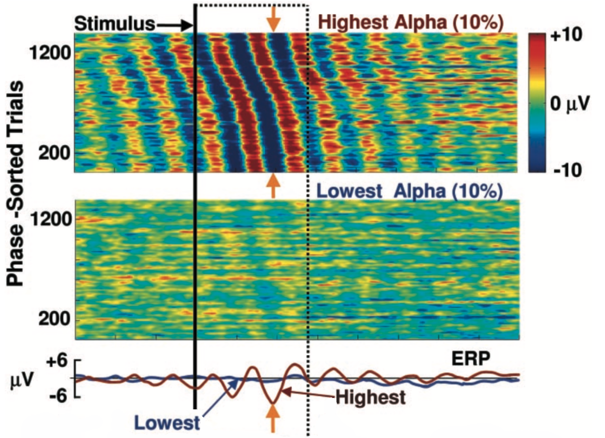
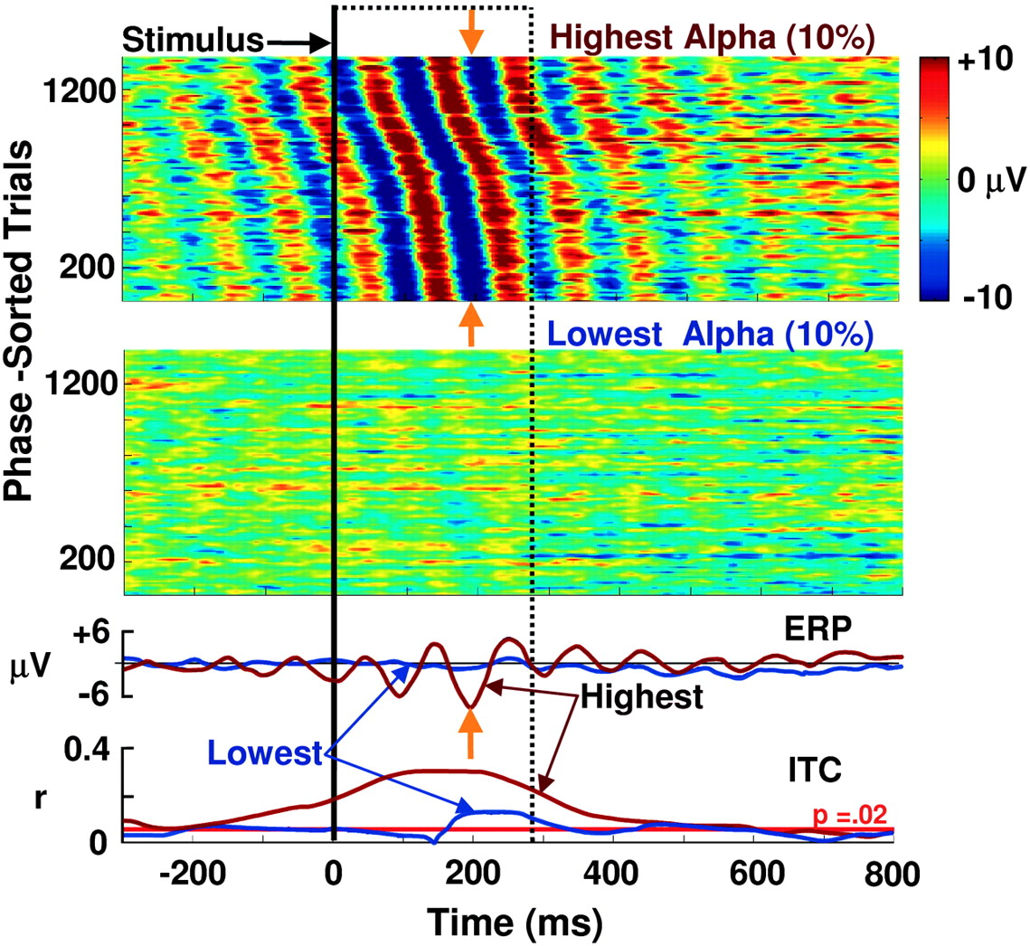
Phase synchronization and ERP
The ERP arises from partial phase synchronization
Makeig et al. (2001) Science, volume 295, Number 5555, pp. 690-694
Notes:
This figures show 3 single-trial EEG epochs time-locked to occurrences of target stimuli and measured at one central electrode (Cz). In stead of plotting potentials in time series, we can plot potentials in different colors according to the color bar on the right. We can stack all target responses during a session. This figure shows 390 single-trial ERPs.
Each trace represents one single-trial target epoch.
Time goes left to right from -100 to 900 msec.
Stimuli were presented at the vertical line at Time 0.
The thick line shows the reaction times.
Notice the trial-to-trial fluctuations in reaction time and response latency.
The average of all 390 trials, shown below the ERP image, contains characteristic peaks (including the indicated P1, N1, P2, P3).

Slide 11
EEG Analysis
Goals
Describe dynamic characteristics of brain activity
Describe relation between different regions of brain
Approaches
Time domain
Frequency domain
Time/Frequency

Slide 12
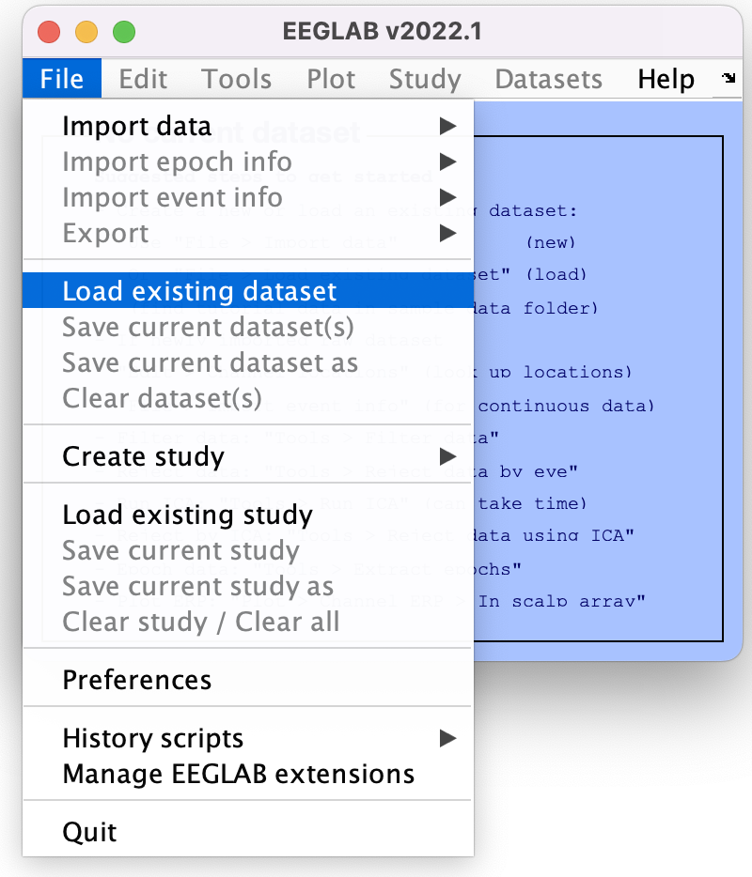
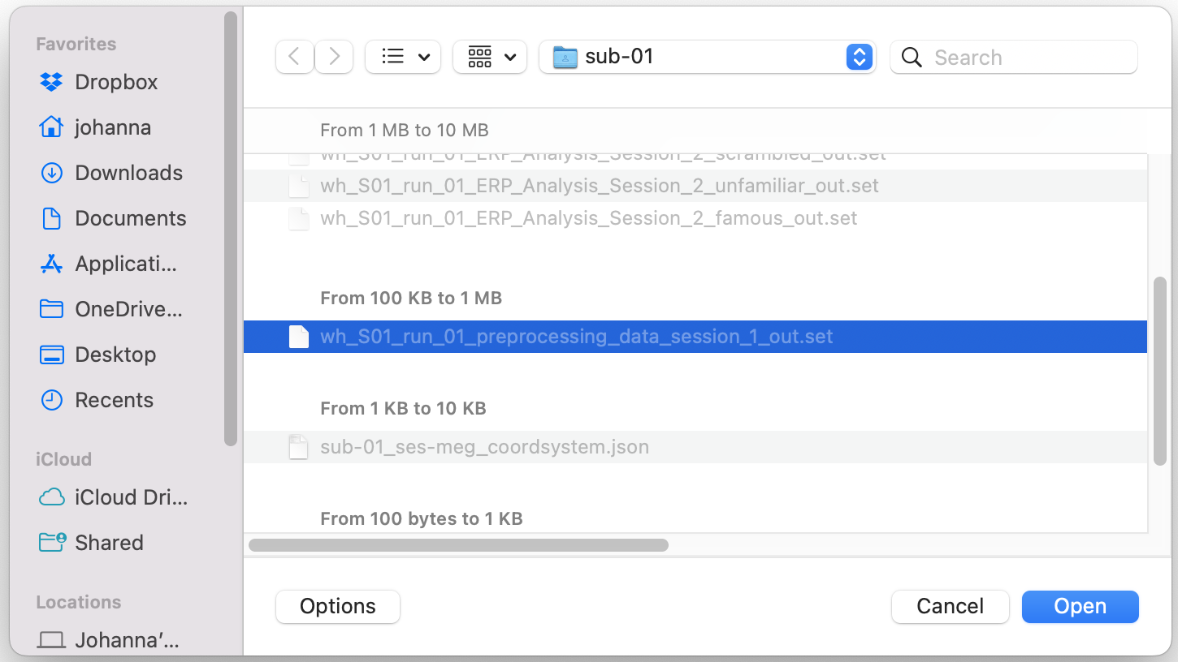
Load Example Dataset
filename = 'wh_S01_run_01_preprocessing_data_session_1_out.set’;
EEG = pop_loadset('filename', filename,'filepath',path2data)

Slide 13
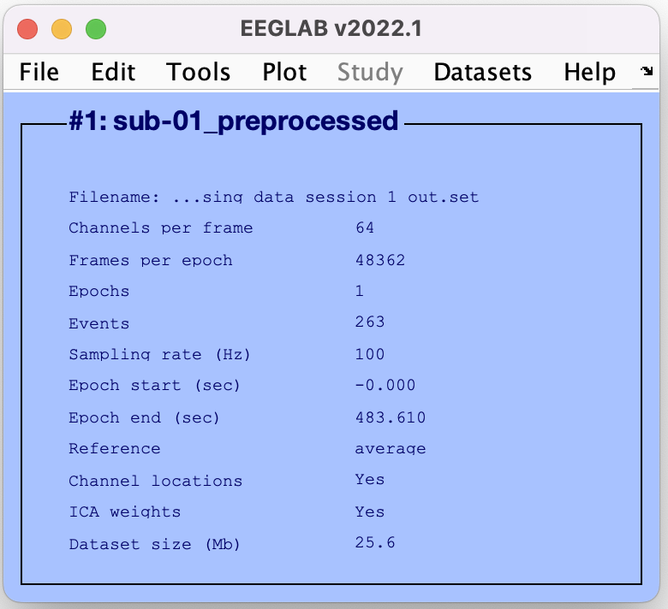
Load Example Dataset

Slide 14
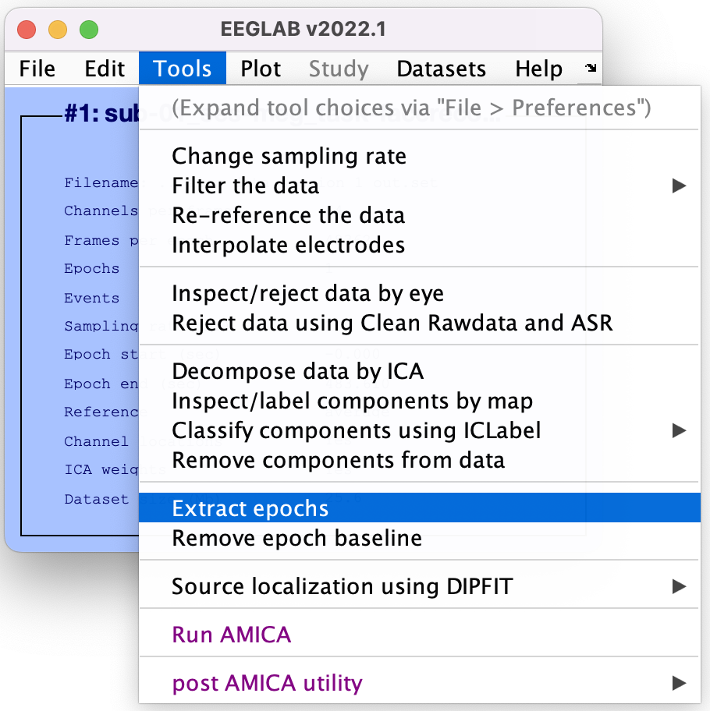
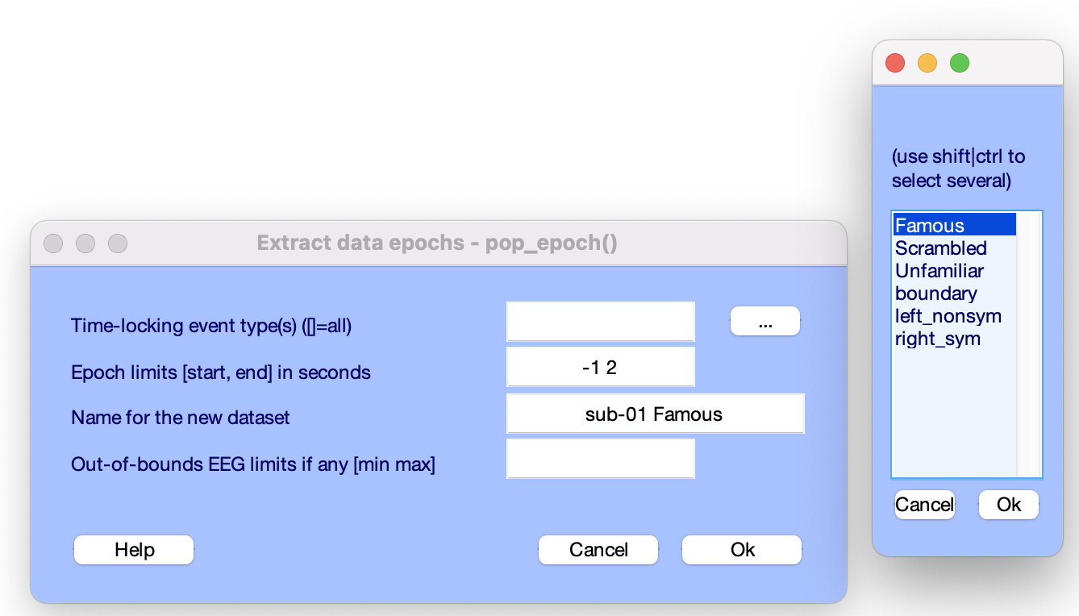
Extract epochs
Event types:
Famous
Unfamiliar
Scrambled

Slide 15
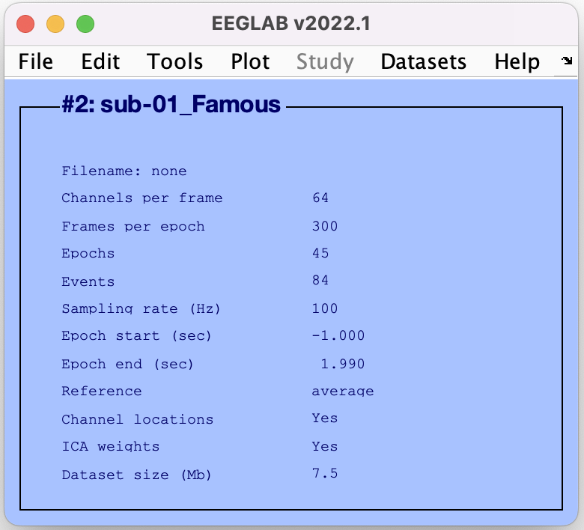
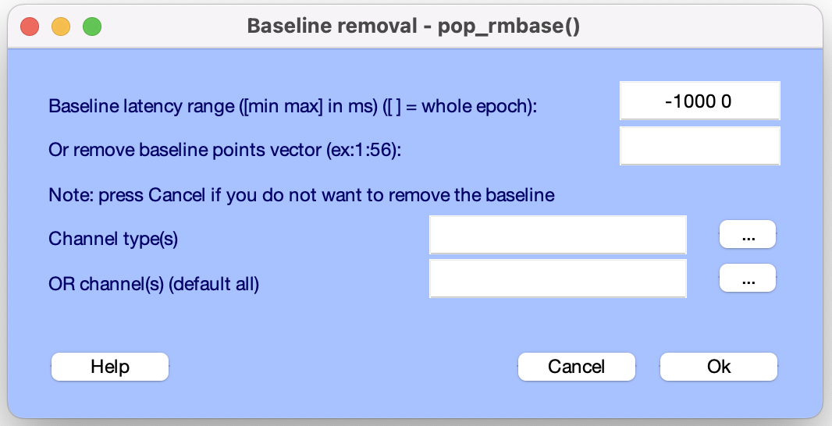
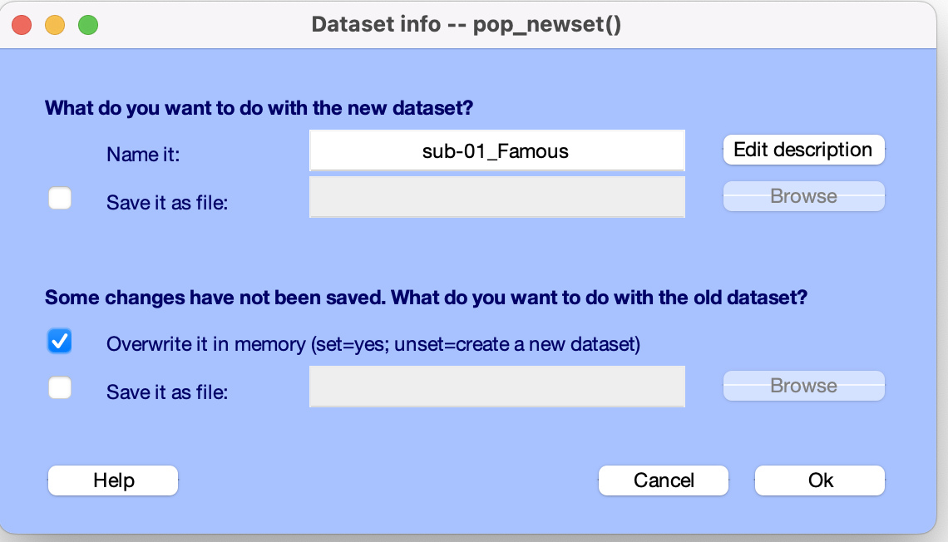
Extract epochs
Remove baseline
Long baseline or no baseline

Slide 16
Extract epochs

Slide 17
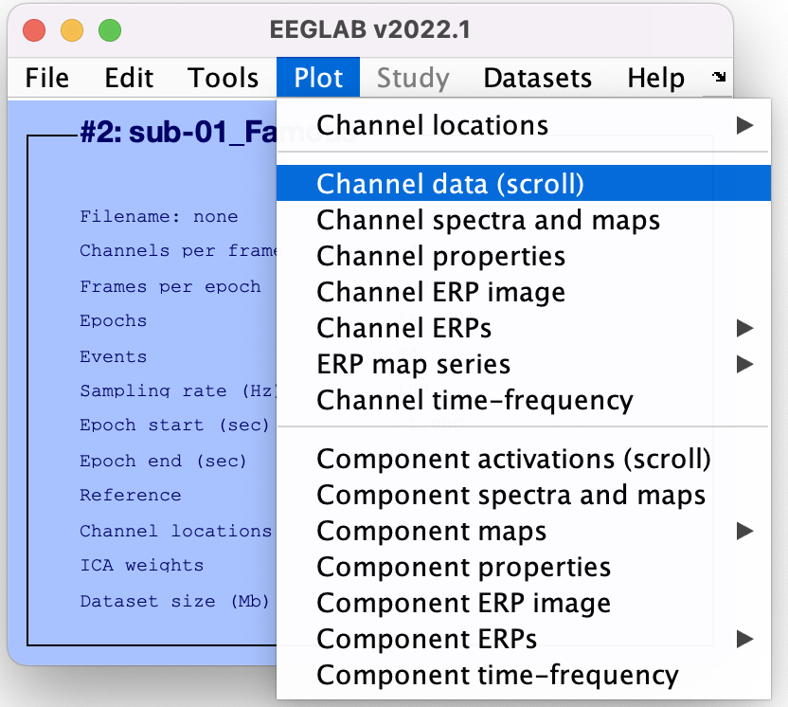
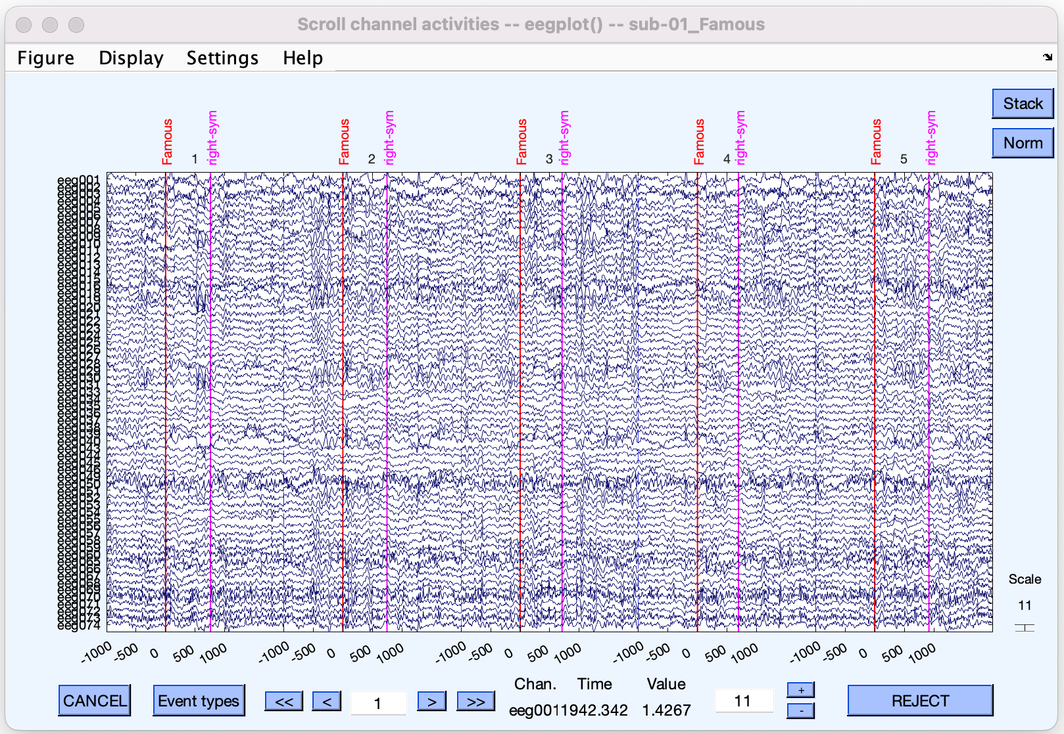
Scroll (epoched) channel data

Slide 18
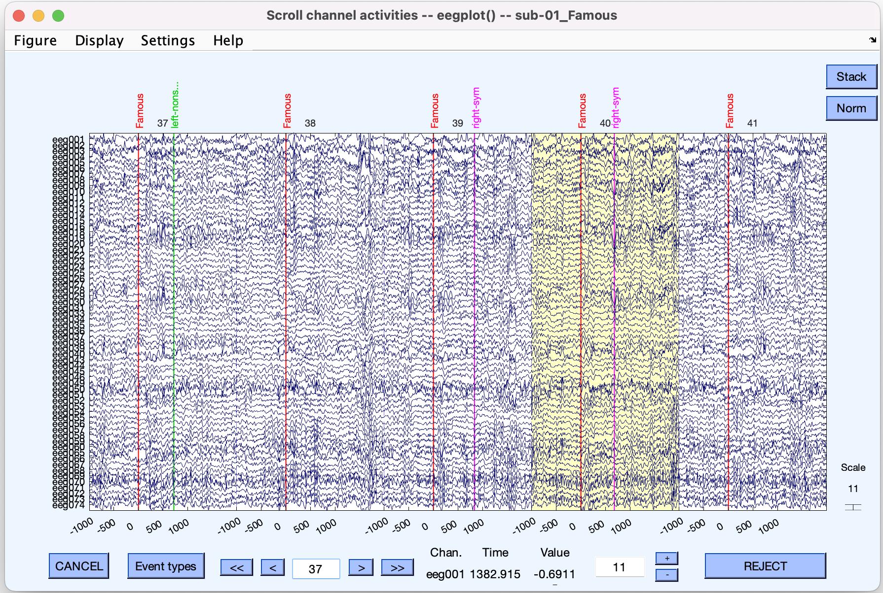
Reject epochs with artifacts
3 s epoch
3 s epoch
3 s epoch
3 s epoch
3 s epoch
Click anywhere within
an epoch to select it
for rejection

Slide 19
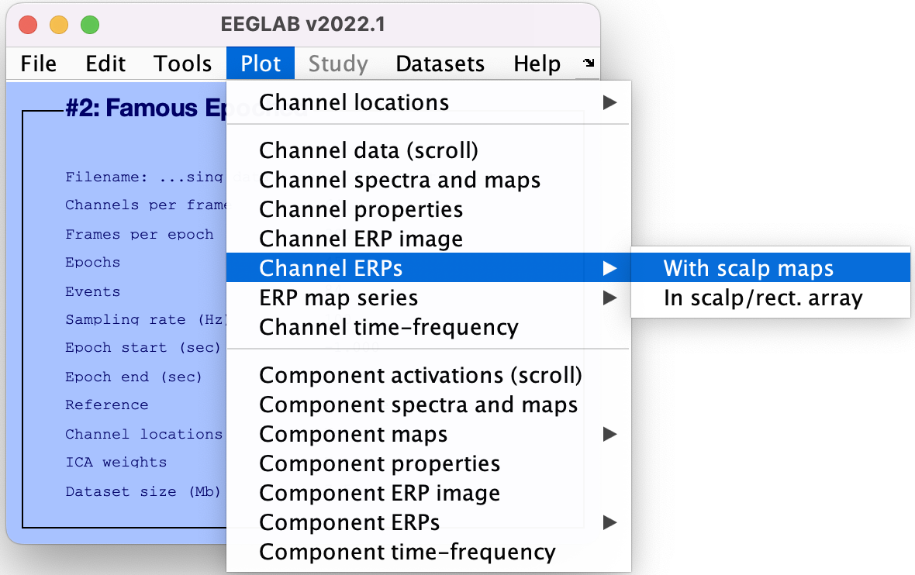
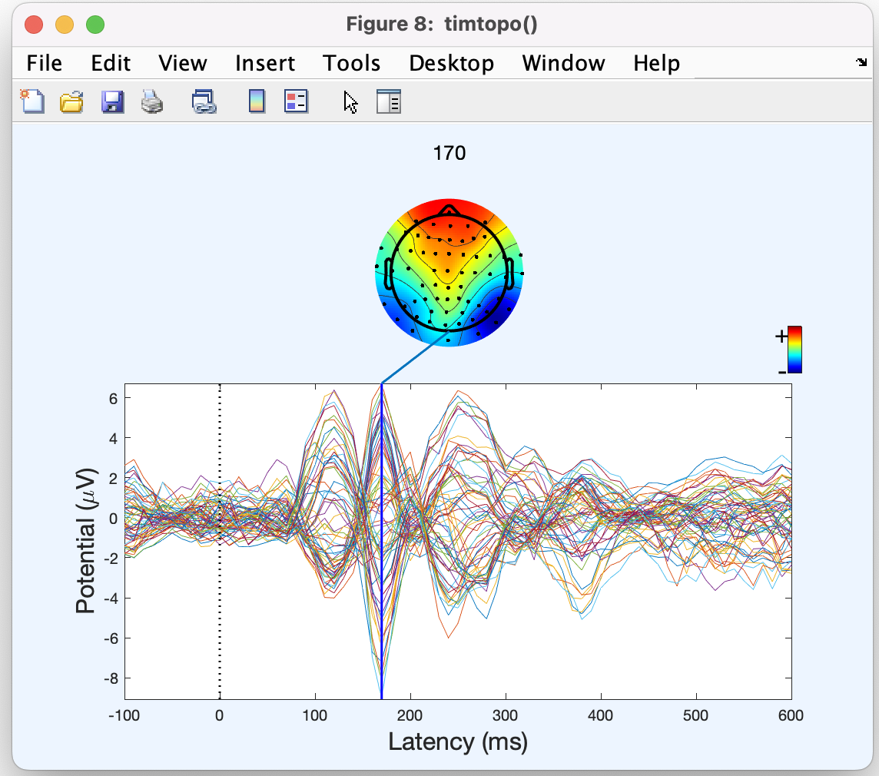
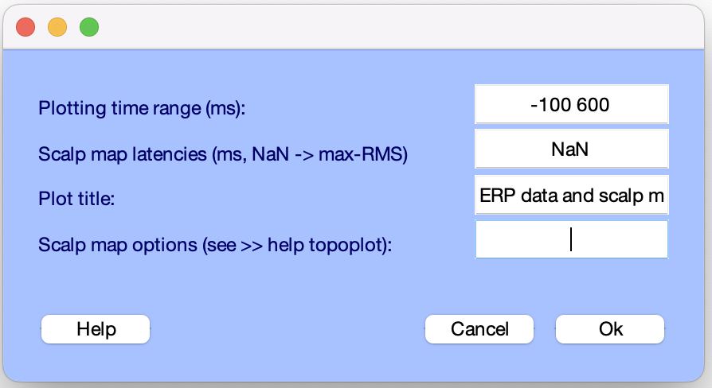
Visualize ERP scalp distribution

Slide 20
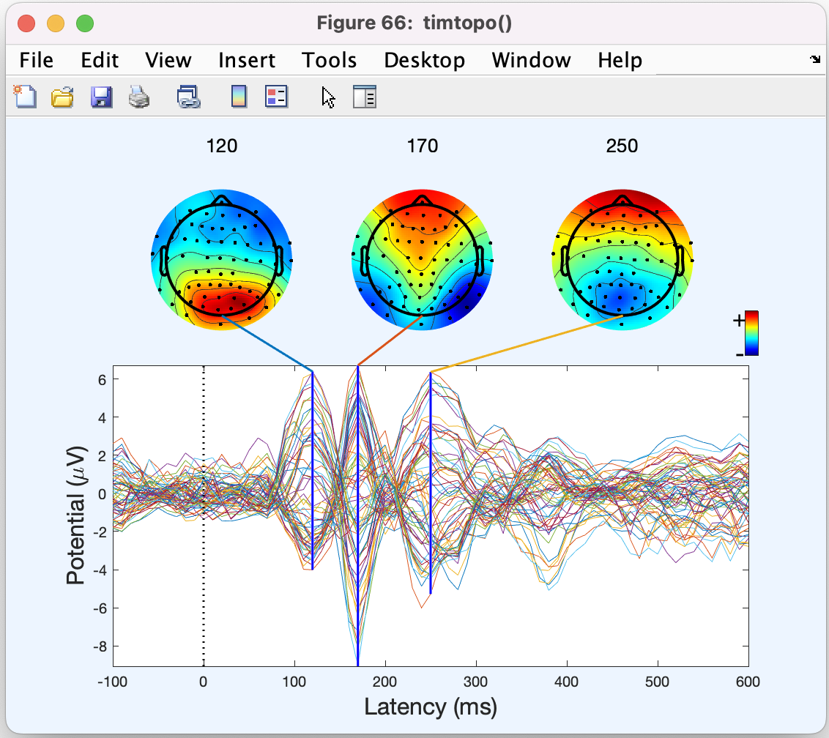
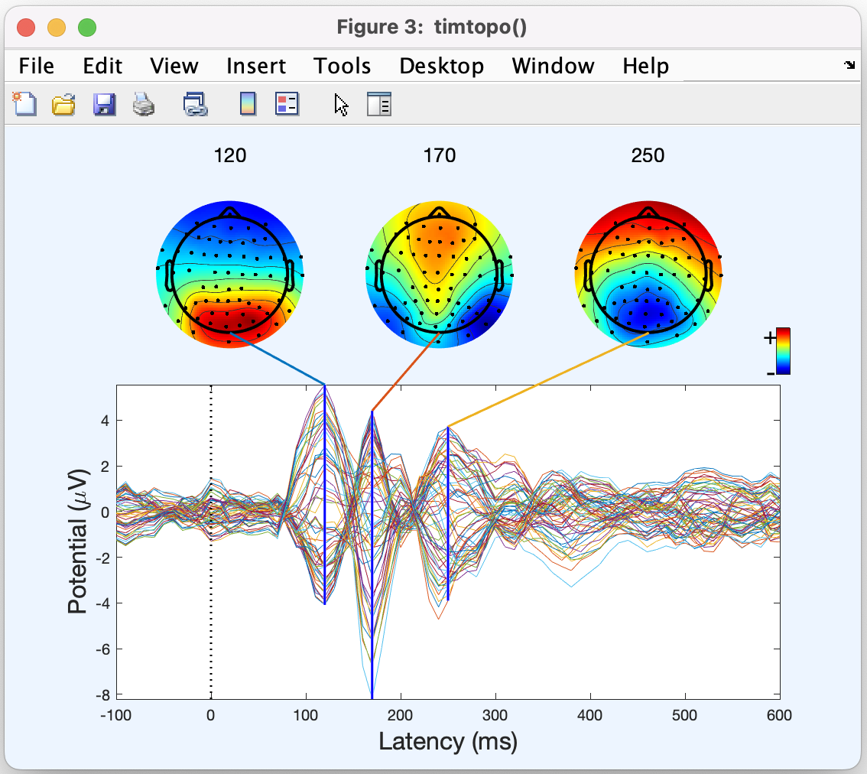
ERP scalp distribution
Before artefact IC removal
After artefact IC removal
Note slightly decreased frontal activity after artefact removal, probably due to removed eye movements

Slide 21
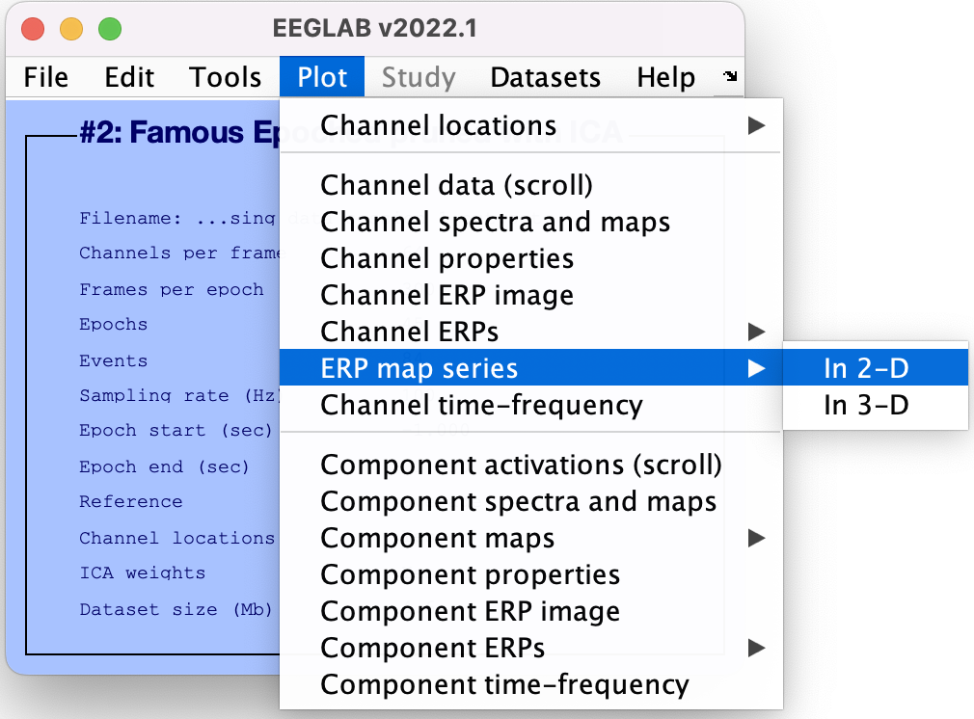
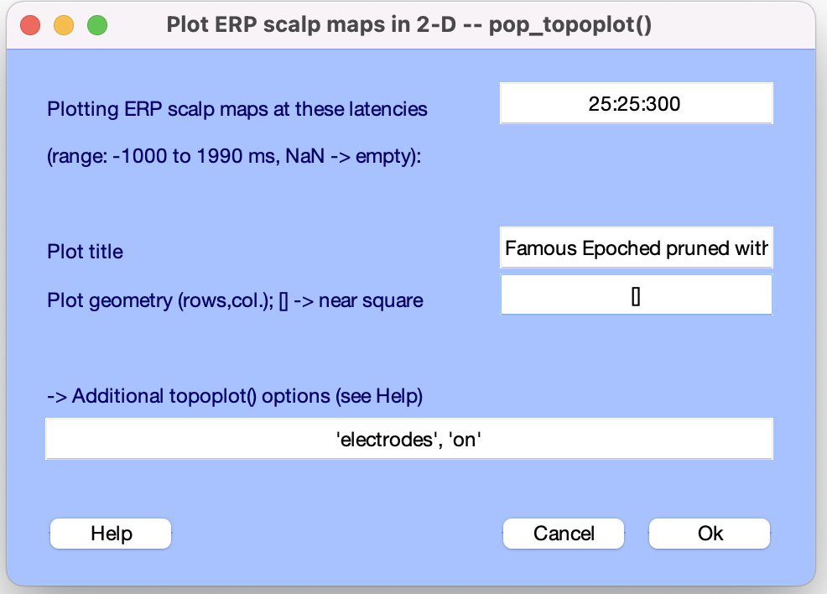
Visualize Channel ERPs in 2 D

Slide 22
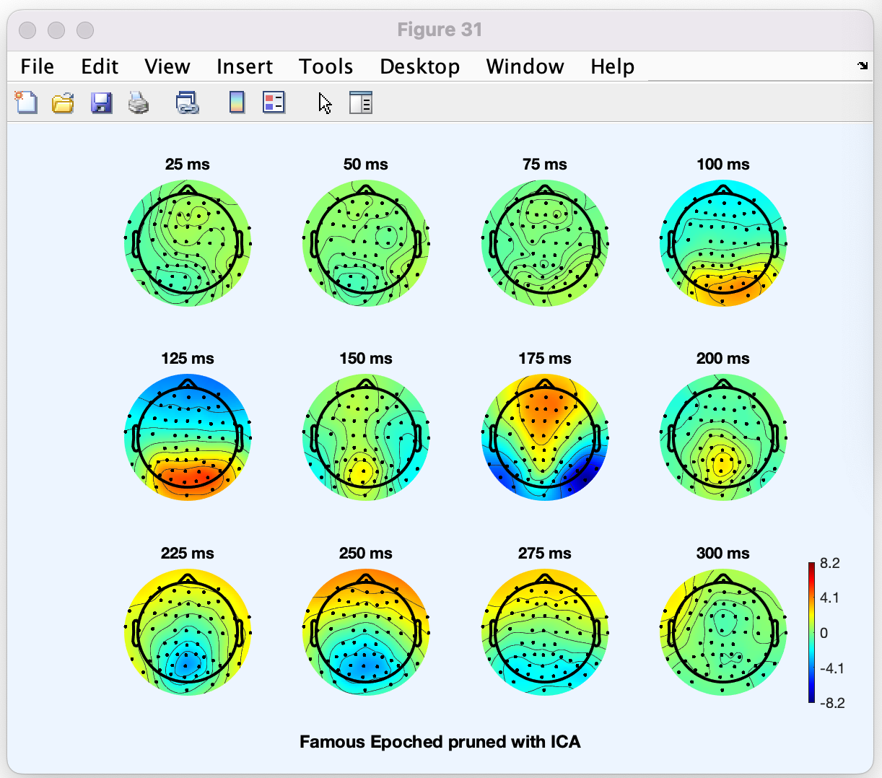
Visualize Channel ERPs in 2 D

Slide 23
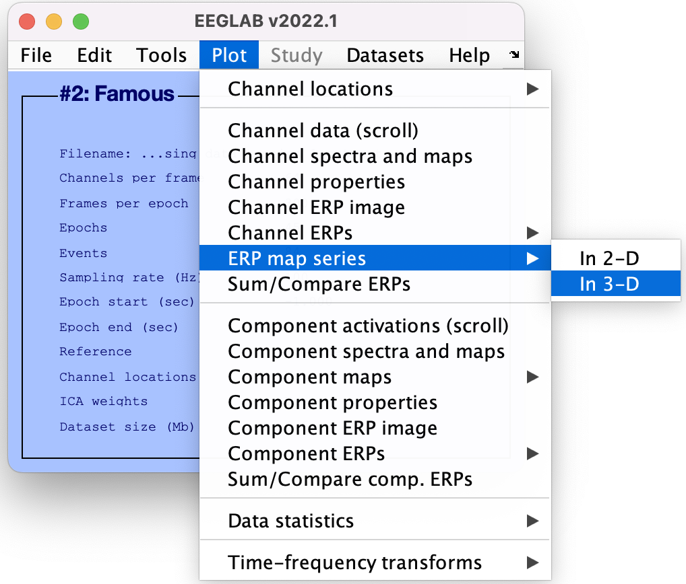
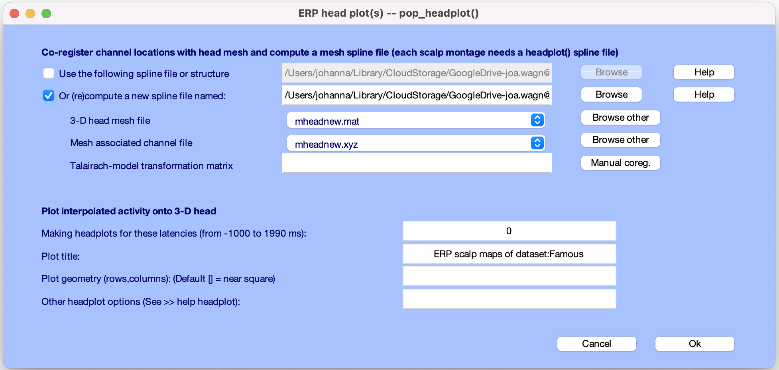
Visualize channel ERPs in 3D
Co-register channels

Slide 24
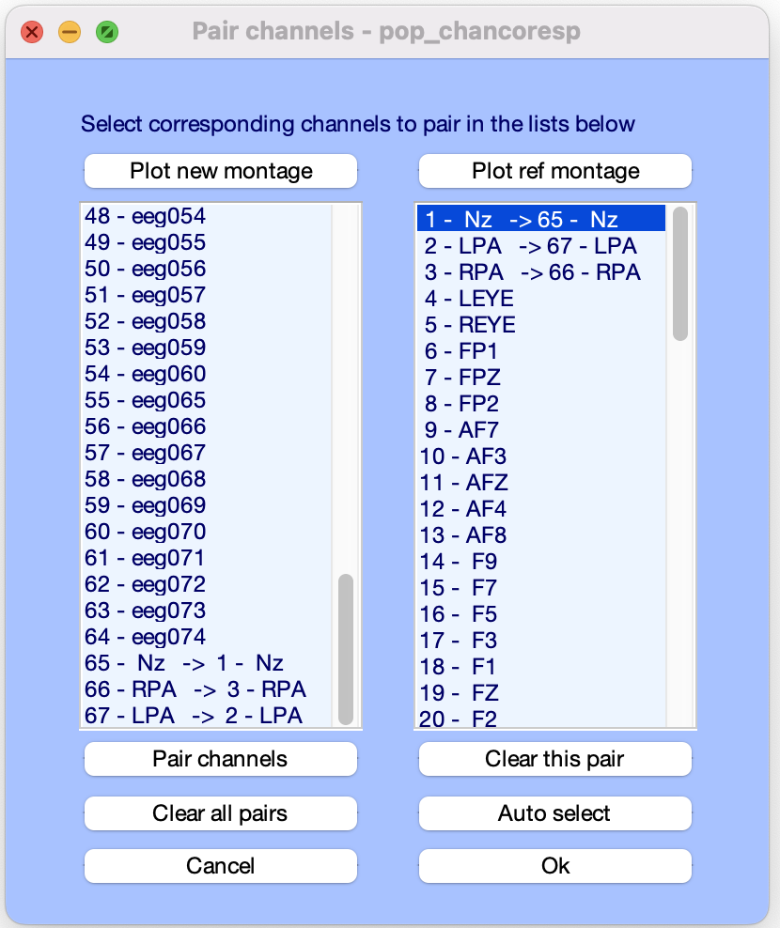
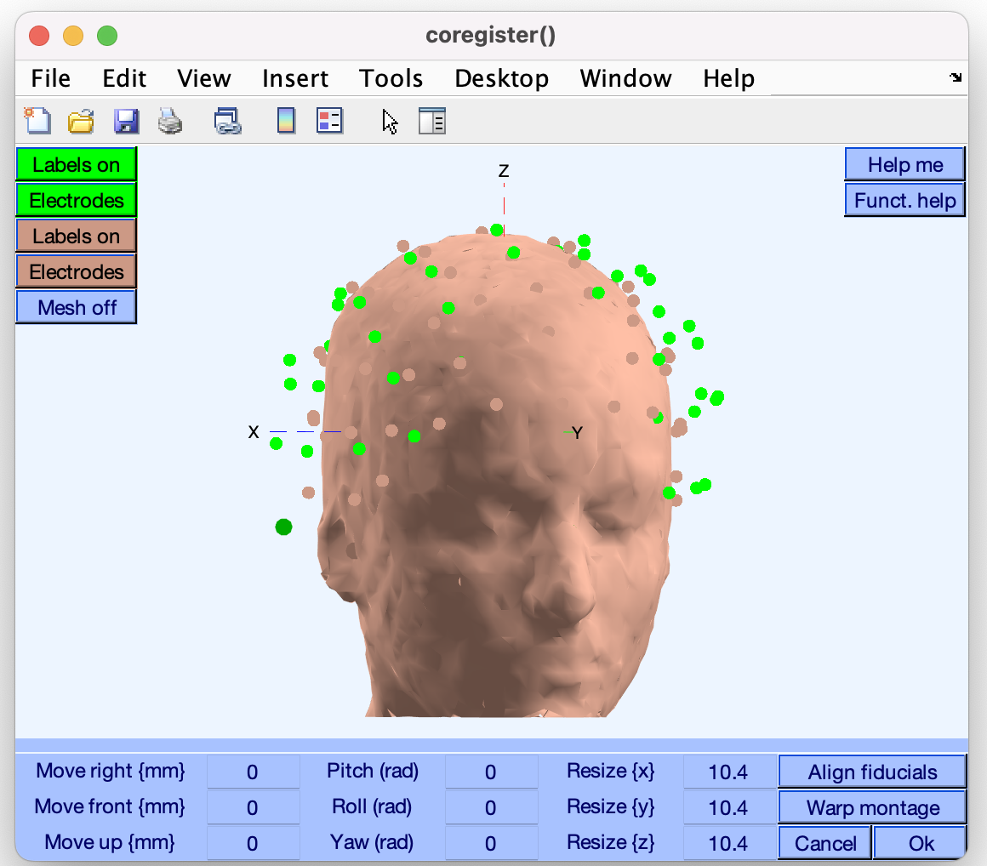
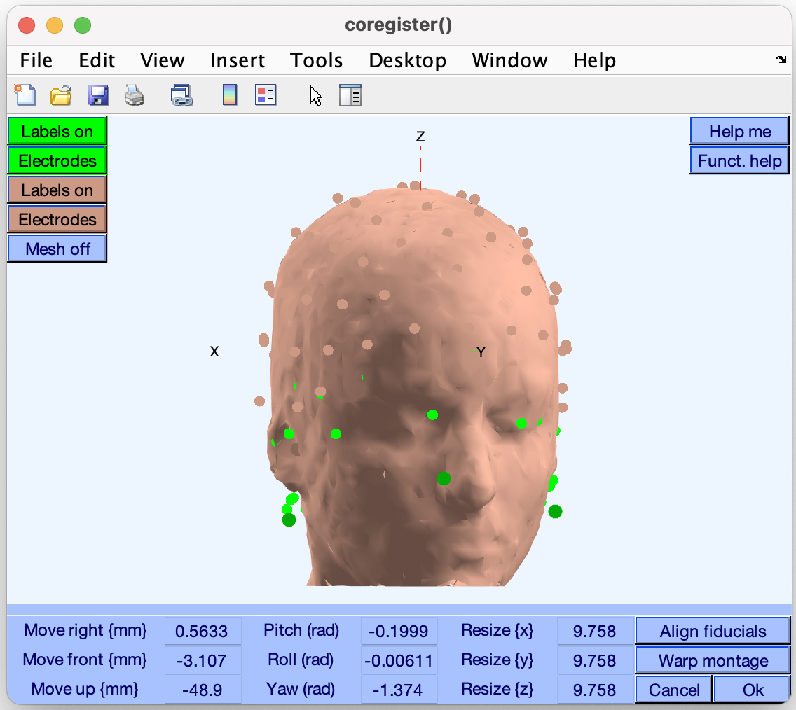
Visualize channel ERPs in 3D
Align fiducials

Slide 25
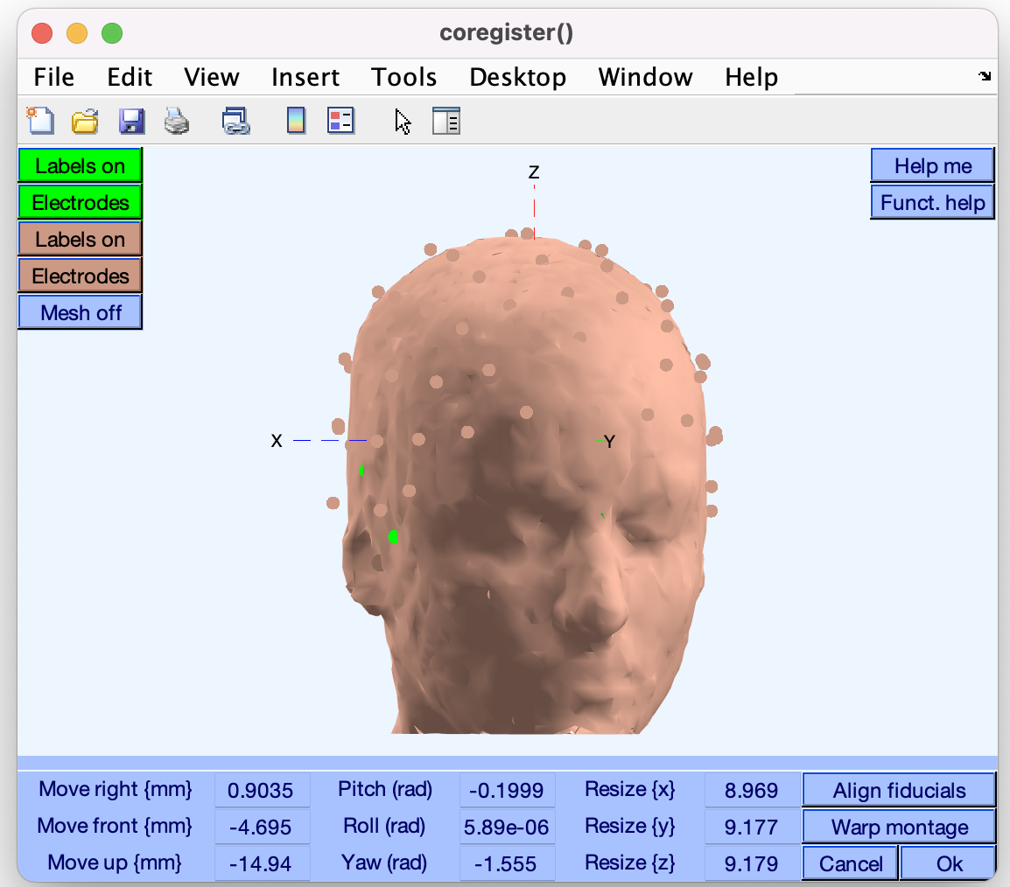
Visualize channel ERPs in 3D
Warp montage

Slide 26
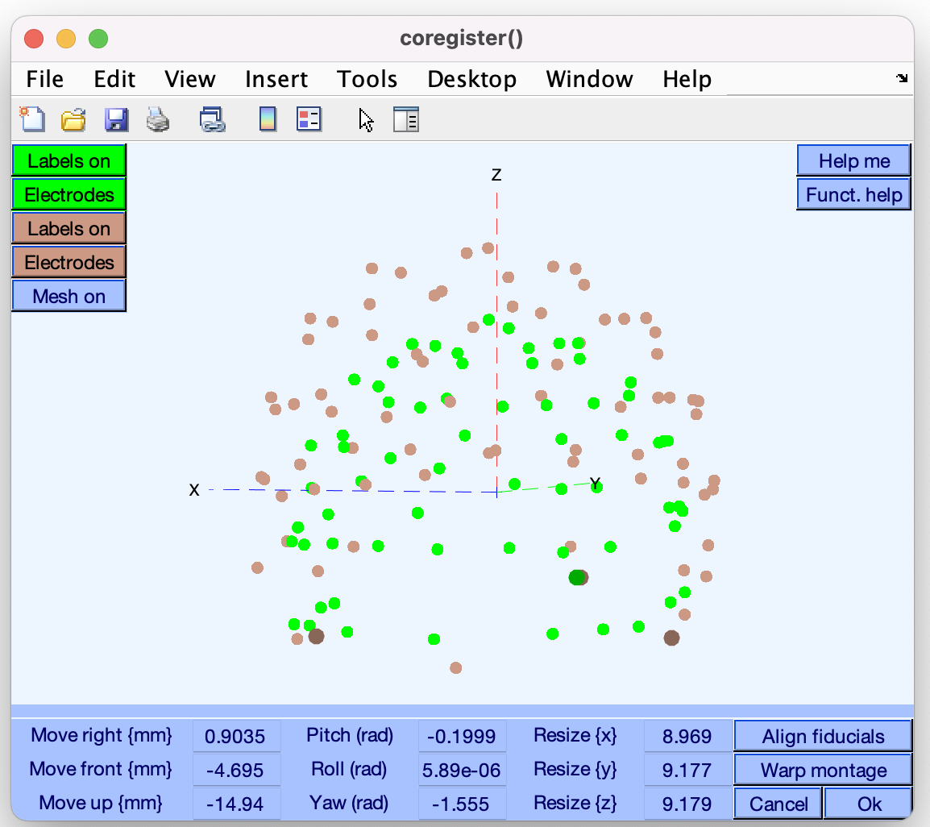
Visualize channel ERPs in 3D
Fiducials are aligned

Slide 27

Visualize channel ERPs in 3D

Slide 28
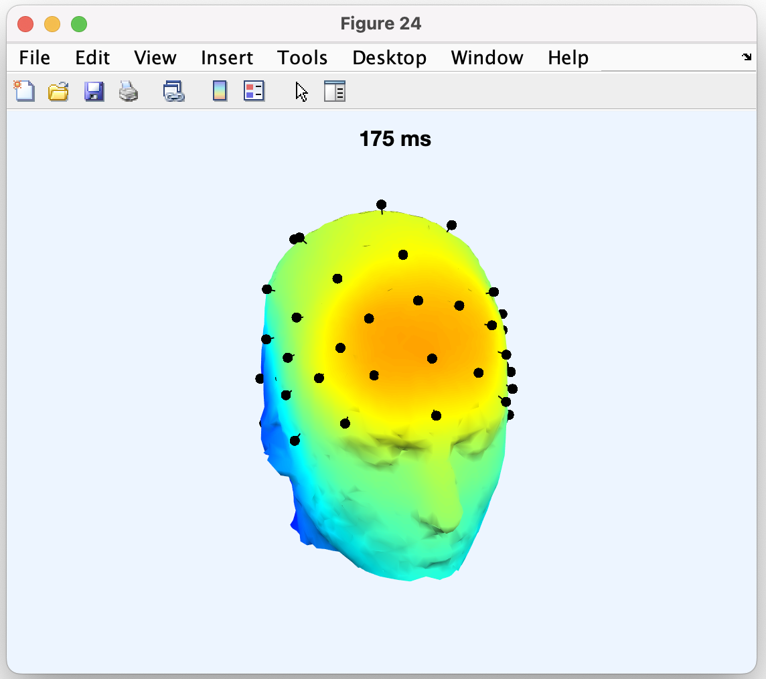
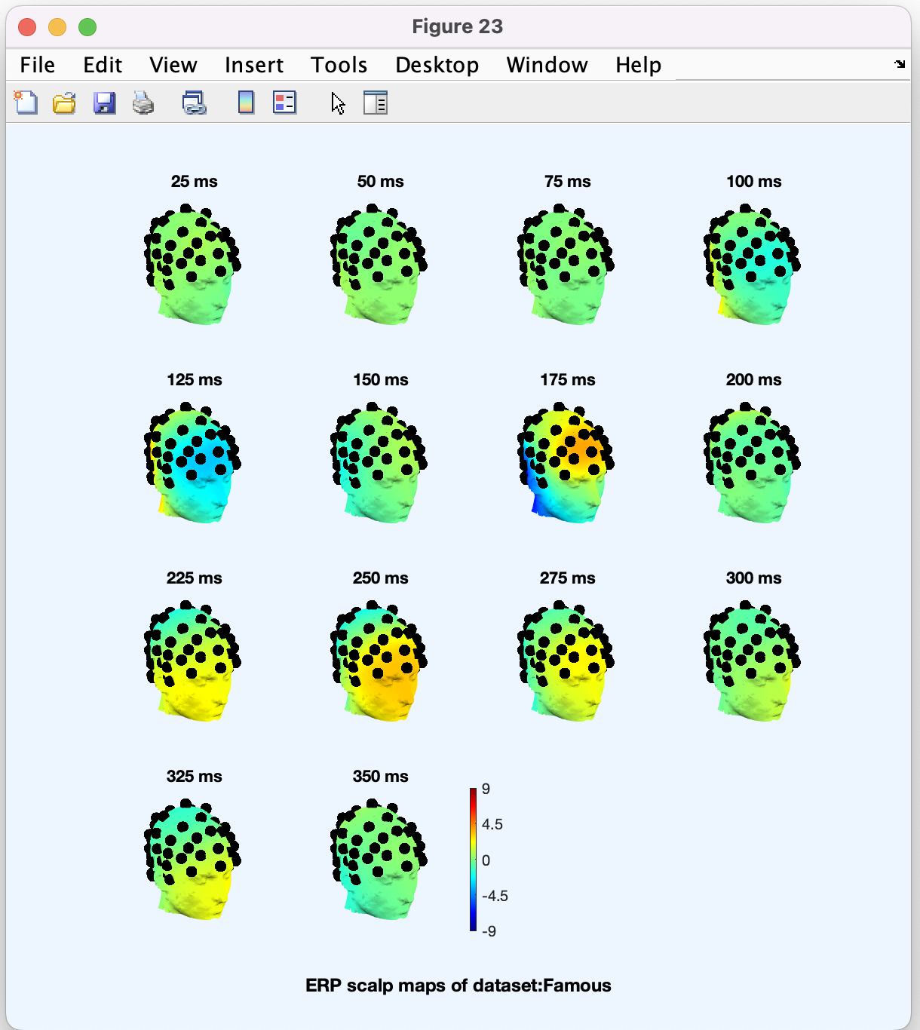
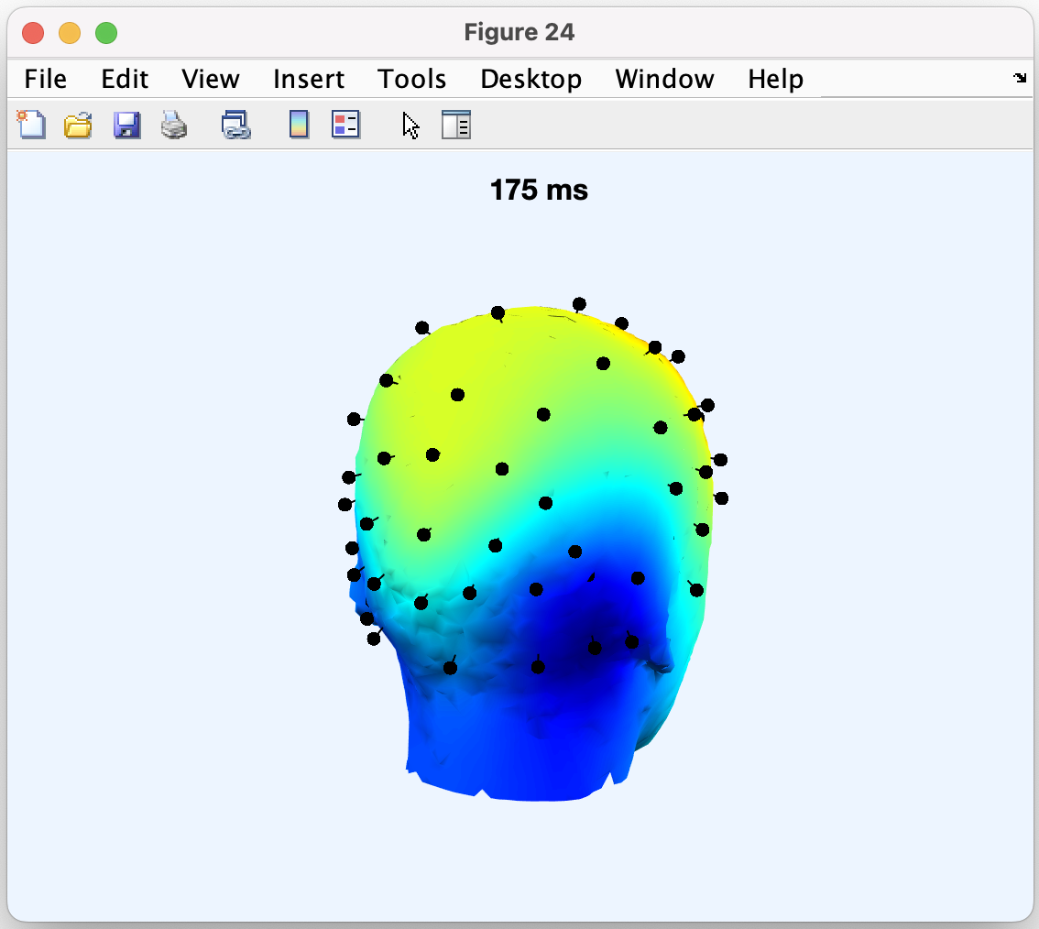
Visualize channel ERPs in 3D
Click on the head

Slide 29
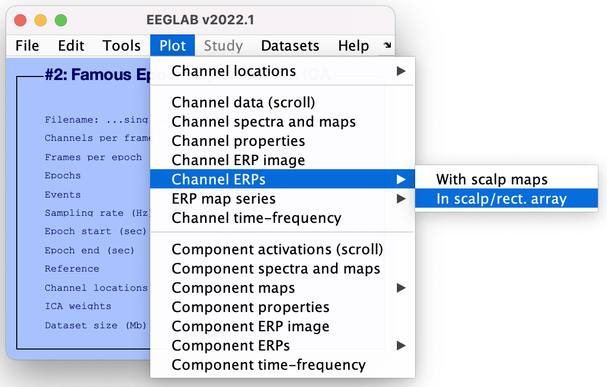
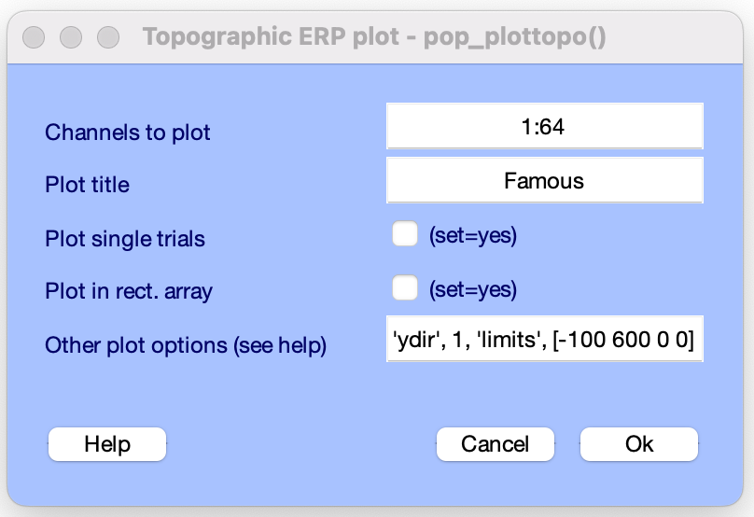
Visualize channel ERPs in topographic array

Slide 30
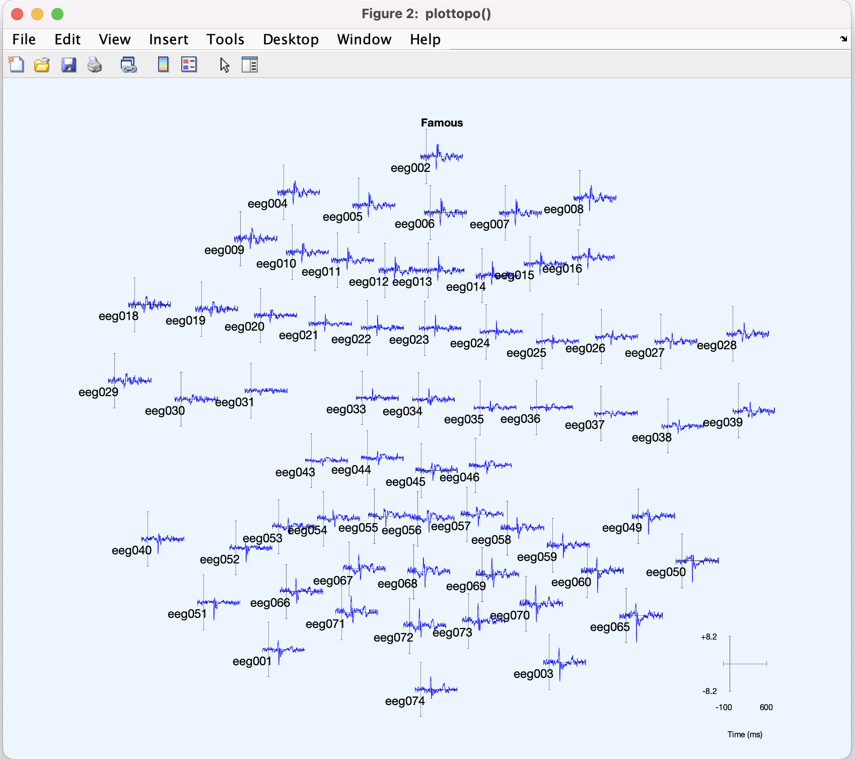
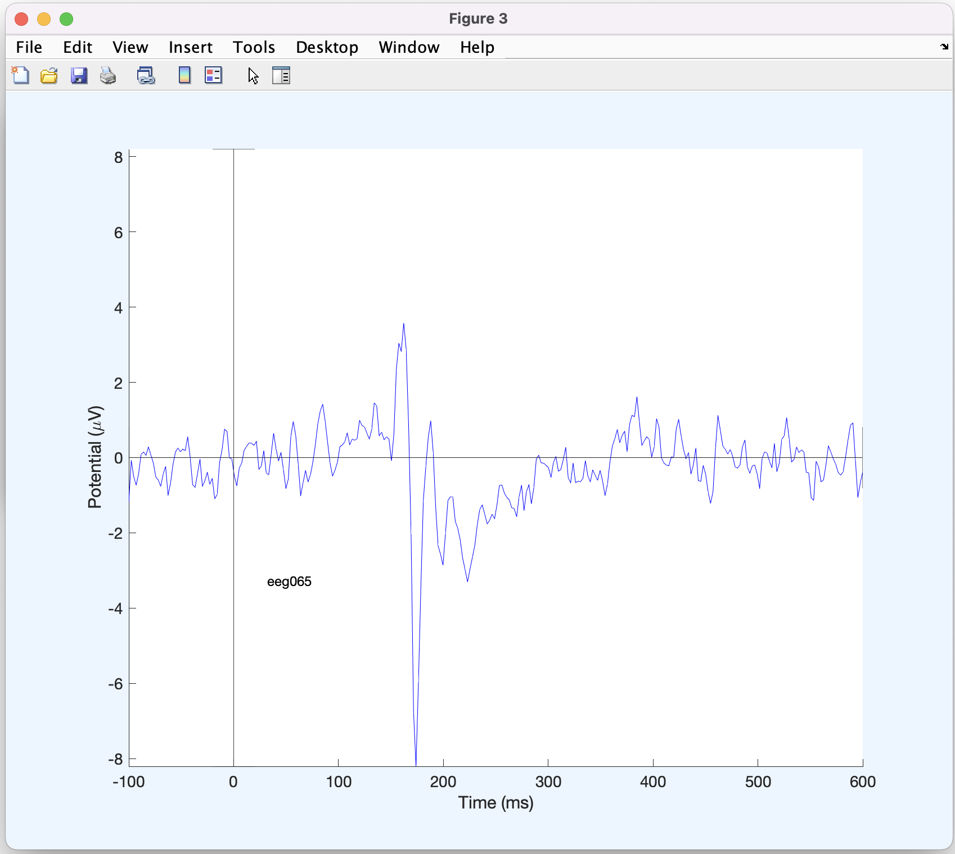
Visualize channel ERPs in topographic array

Slide 31
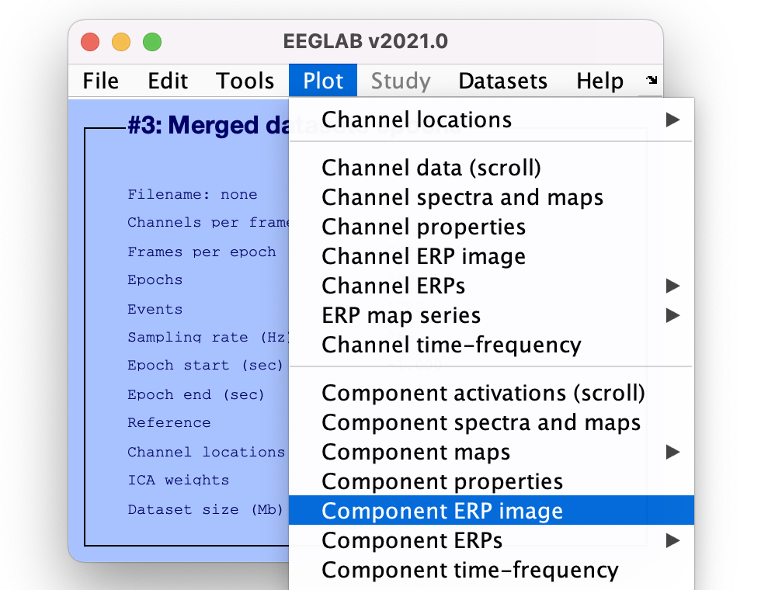
Component ERP image

Slide 32
ERP Image basics
Trial 1
ERP Image
Trial 2
Trial 3
by default, sorted by
time-on-task
(1st trial, 2nd trial, ...)
Trial 4

Slide 33



ERP Image basics
Trial 1:
Trial 2:
.
.
.
+
+
-
-

Slide 34

ERP Images: smoothing across trials

Slide 35



Channel ERP Image

Slide 36

Definition: The data envelope
Data (all channels)
Data envelope (max/min traces)

Slide 37

Definition: IC Envelope
IC 5 Topography
Data Envelope
IC Envelope
IC 5 Activation ERP
back-projected
to channels

Slide 38

Key: Scalp ERP peaks are often the sum of multiple independent source processes
This component accounts for almost all of the negative scalp ERP peak at ~180 ms, but only some of other ERP peaks
Net PPAF: 33%
PPAF
“% Variance
Accounted For”
The variance of scalp
EEG accounted for
by this component

Slide 39


Component ERP envelope

Slide 40

IC contributions to ERP envelope

Slide 41

IC contributions to ERP envelope

Slide 42

IC contributions to ERP envelope
Removing artefact ICs

Slide 43

IC contributions to ERP envelope
Removing artefact ICs

Slide 44


IC ERP difference between two conditions

Slide 45

IC ERP difference between two conditions

Slide 46

Plot maximum contributing components

Slide 47

Plot maximum contributing components
Maximum contributing ICs from 0 to 400ms
Channel scalp distribution
Note the similarity in channel scalp topography at the 3 ERP peaks and IC topography - ICA is able to separate the 3 distinct brain processes
reflected in the 3 ERP peaks

Slide 48
Hands On!
Import preprocessed file using menu item File > load existing dataset ds000117_pruned/derivatives/meg_derivatives/sub-01/ses-meg/meg/ wh_S01_run_01_preprocessing_data_session_1_out.set
(run script_01_import_data.m and script_02_preprocess_data.m to generate this file)
Extract epochs for famous stimuli using menu Tools > Extract epochs. Leave all defaults (minus 1 to 2 seconds). Do not remove the baseline.
Plot envelope and look at scalp topography at 170 ms (face-related potential) using menu item Plot > Plot channel ERPs > With scalp maps
Plot ERPimage for channel 65 between -100 ms and 500 ms using menu item Plot > Plot ERPimage
Plot ICA component contribution to the ERP between 100 ms and 200 ms using menu item Plot > Plot component ERPs > With component maps
(run script_03_epochs_and_erp.m to generate data epochs files for famous, scrambled and unfamiliar stimuli – these files are used in subsequent lectures)

